Slide 1
Greedy Algorithms

Slide 2
Divide and Conquer (Recap)
Big problem
sub-problem
sub-problem
sub-sub-problem
sub-sub-problem
sub-sub-problem
sub-sub-problem
sub-sub-problem

Slide 3
Dynamic Programming (Recap)
Big problem
sub-problem
sub-problem
sub-problem
sub-sub-problem
sub-sub-problem
sub-sub-problem
sub-sub-problem

Slide 4
Greedy Algorithms
Make greedy choices one-at-a-time.
Never look back.
Hope (prove) that the greedy choice leads to optimal solution.

Slide 5
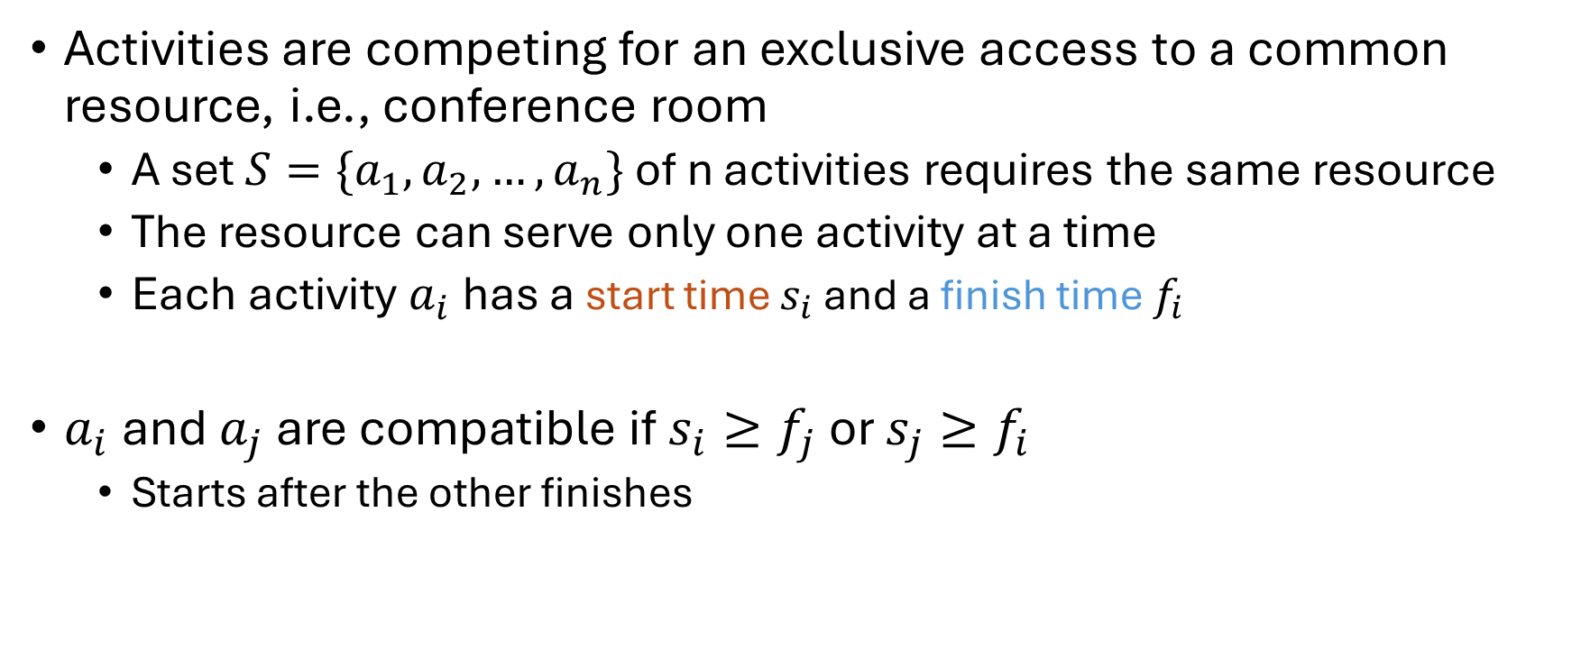
Activity Selection Problem
Activities are competing for an exclusive access to a common resource, i.e., conference room
A set $S=\{a_{1}, a_{2}, …, a_{n}\}$ of n activities requires the same resource
The resource can serve only one activity at a time
Each activity $a_{i}$has a start time $s_{i}$ and a finish time $f_{i}$
$a_{i}$and $a_{j}$ are compatible if $s_{i}≥f_{j}$or $s_{j}≥f_{i}$
Starts after the other finishes

Slide 6
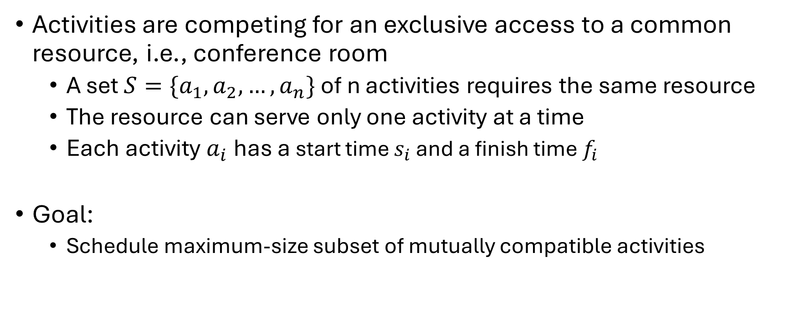
Activity Selection Problem
Activities are competing for an exclusive access to a common resource, i.e., conference room
A set $S=\{a_{1}, a_{2}, …, a_{n}\}$ of n activities requires the same resource
The resource can serve only one activity at a time
Each activity $a_{i}$has a start time $s_{i}$ and a finish time $f_{i}$
Goal:
Schedule maximum-size subset of mutually compatible activities

Slide 7

Activity Selection Problem
Assumption: The activities are sorted by their finish times
$f_{1}≤f_{2}≤f_{3}≤ …≤f_{n}$
If not, sort with $O(n lgn)$

Slide 8
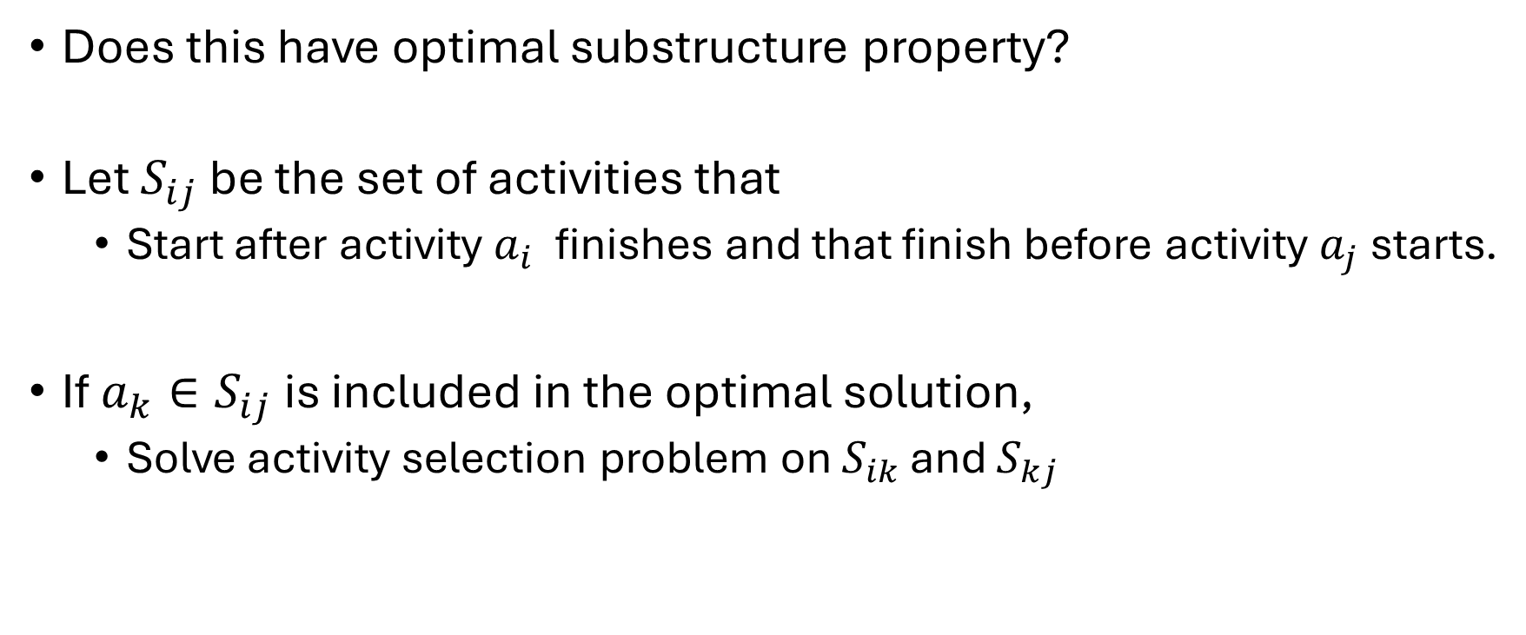
Activity Selection Problem
Does this have optimal substructure property?
Let $S_{ij}$ be the set of activities that
Start after activity $a_{i}$ finishes and that finish before activity $a_{j}$starts.
If$a_{k}∈S_{ij}$ is included in the optimal solution,
Solve activity selection problem on $S_{ik}$ and $S_{kj}$

Slide 9

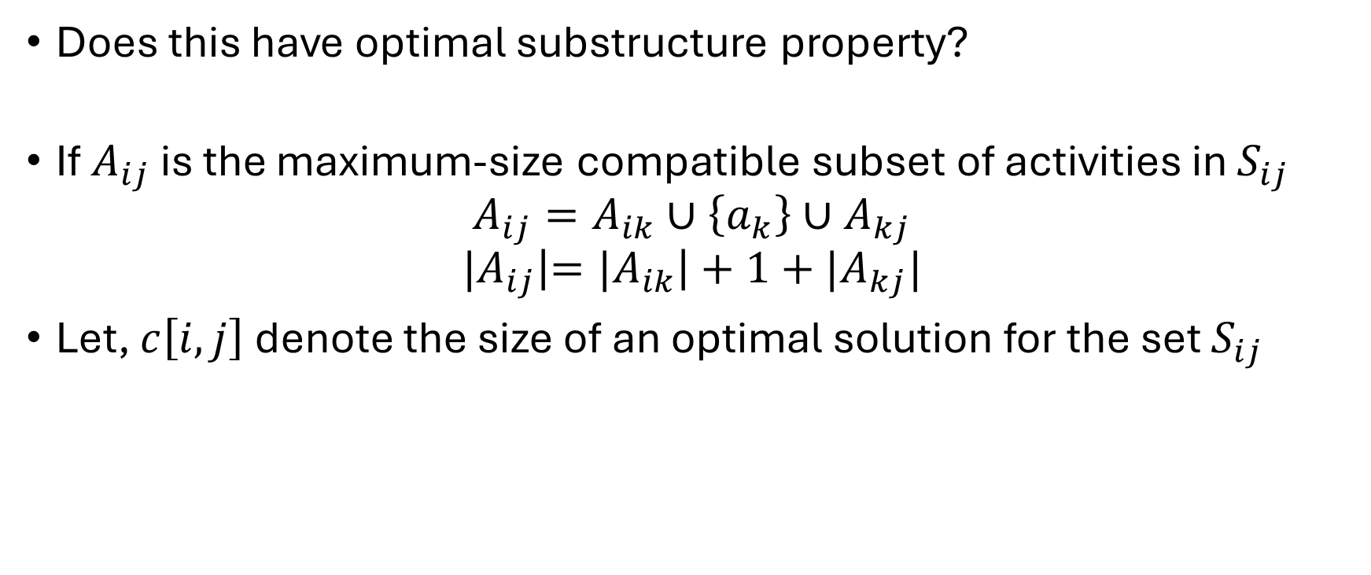
Activity Selection Problem
Does this have optimal substructure property?
If $A_{ij}$ is the maximum-size compatible subset of activities in $S_{ij}$
$$A_{ij}=A_{ik}∪\left\{a_{k}\right\}∪A_{kj}$$
$${|A}_{ij}\left|={|A}_{ik}\right|+1+{|A}_{kj}|$$
Let, $c\left[i,j\right]$ denote the size of an optimal solution for the set $S_{ij}$

Slide 10
Activity Selection Problem
Does this have optimal substructure property?
Yes!!!
Can also use cut-and-paste argument for proof
DP??

Slide 11
Activity Selection Problem
Let’s make a greedy choice
Choose the activity that leaves the resource available for as many other activities as possible
Any optimal solution has an activity that finishes first
Here, choose the activity in S with the earliest finish time,
Leave the resource available for maximum number of other activities

Slide 12
Activity Selection Problem
Let’s make a greedy choice
Choose the activity with earliest finish time
Once a greedy choice is made,
There is only one remaining subproblem to solve
Solve for the activities that starts after the first-choice finishes

Slide 13

Activity Selection Problem
Let $S_{k}=\{a_{i}∈S;s_{i}≥f_{k}\}$
Once we have picked $a_{k}$, all we need to solve is $S_{k}$
Optimal Substructure Property

Slide 14
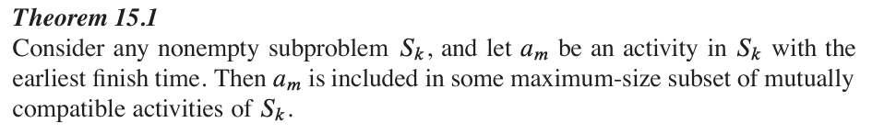
Activity Selection Problem
The greedy choice
Choose the activity with earliest finish time
Is it optimal?

Slide 15
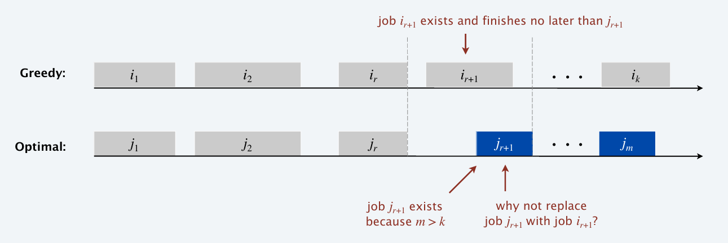
Activity Selection Problem

Slide 16
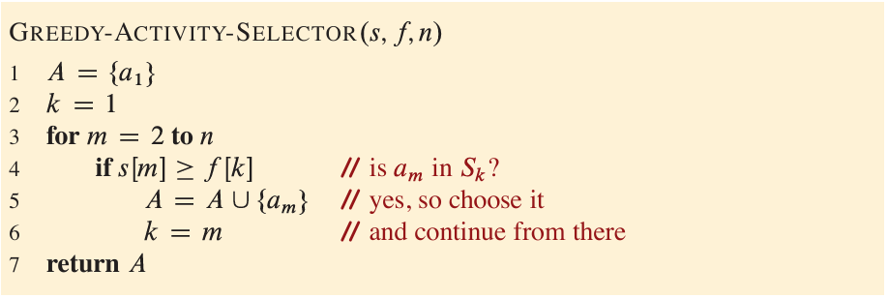
Activity Selection Problem

Slide 17
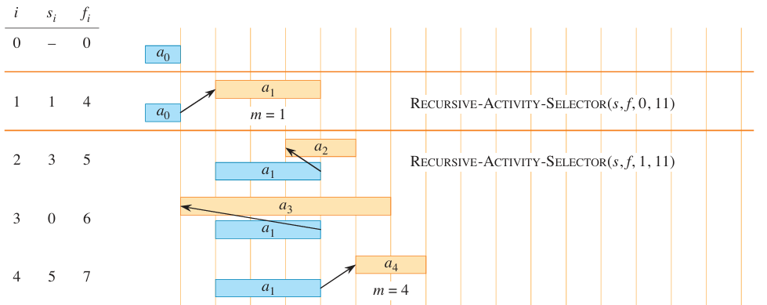
Activity Selection Problem

Slide 18
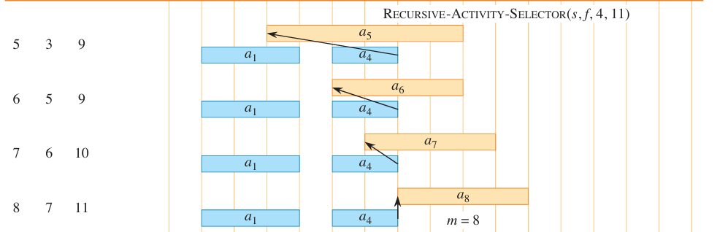
Activity Selection Problem

Slide 19
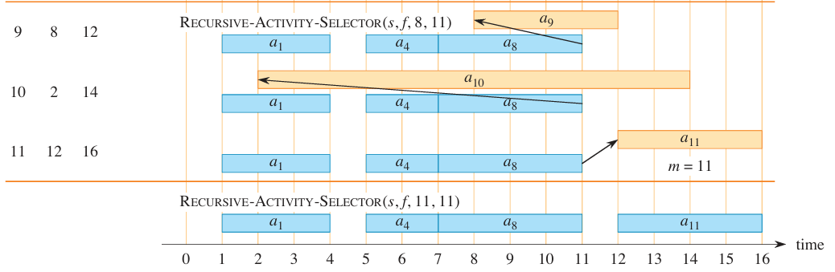
Activity Selection Problem

Slide 20
Elements of Greedy Strategy
Optimal Substructure property
Greedy Choice Property
Assemble a globally optimal solution by making locally optimal (greedy) choices.
Make the choice that looks best in the current problem, without considering results from subproblems.

Slide 21
Elements of Greedy Strategy
Big problem
sub-problem
sub-sub-problem

Slide 22
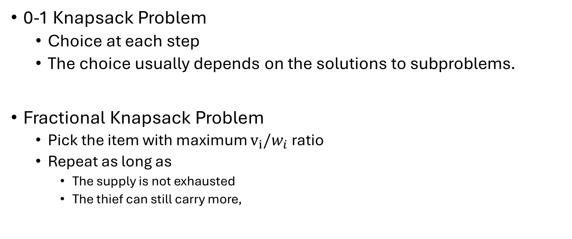
Knapsack Problems
0-1 Knapsack Problem
Choice at each step
The choice usually depends on the solutions to subproblems.
Fractional Knapsack Problem
Pick the item with maximum $v_{i}/w_{i}$ ratio
Repeat as long as
The supply is not exhausted
The thief can still carry more,

Slide 23
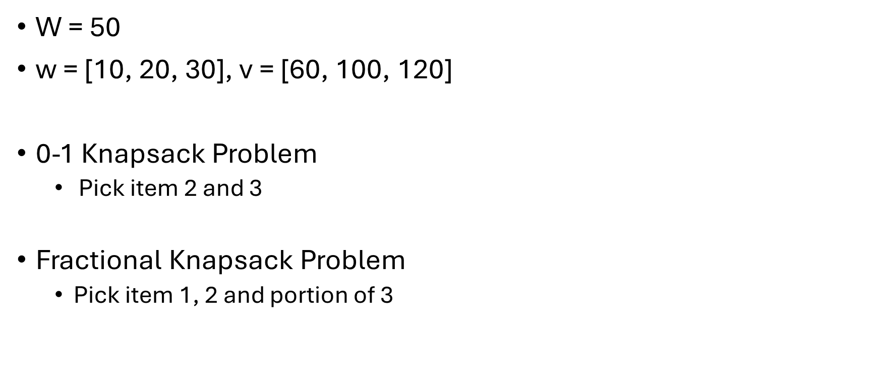
Knapsack Problems
W = 50
$\text{w}\text{ = [10, 20, 30], }\text{v}\text{ = [60, 100, 120]}$
0-1 Knapsack Problem
Pick item 2 and 3
Fractional Knapsack Problem
Pick item 1, 2 and portion of 3

Slide 24
Single Source Shortest Path
Given
A weighted and directed graph, G = (V, E)
A source, s
Goal: Find out the shortest path weight from the source to a given node / other nodes.
What about unweighted graphs?

Slide 25
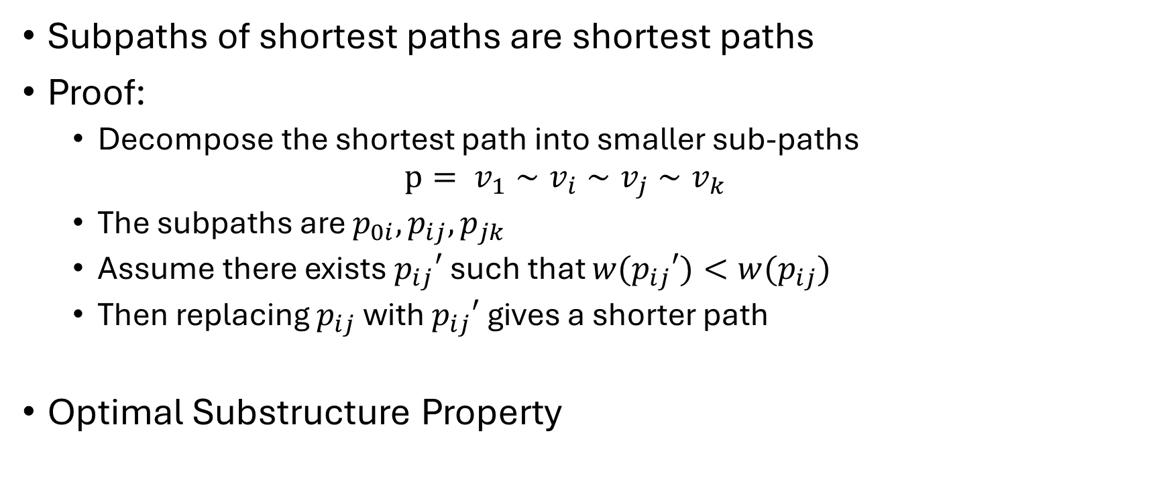
Single Source Shortest Path
Subpaths of shortest paths are shortest paths
Proof:
Decompose the shortest path into smaller sub-paths
$$p= v_{1}∼v_{i}∼v_{j}∼v_{k}$$
The subpaths are $p_{0i}, p_{ij}, p_{jk}$
Assume there exists $p_{ij}′$ such that ${w(p}_{ij}′)<w(p_{ij})$
Then replacing $p_{ij}$ with $p_{ij}′$ gives a shorter path
Optimal Substructure Property

Slide 26
Single Source Shortest Path
Negative-weight Edges
Graph may contain negative weight cycles reachable from source s
Shortest path problem is not well-defined
Cycle
Shortest path cannot contain cycle
Just dropping the cycle gives a lower cost path

Slide 27
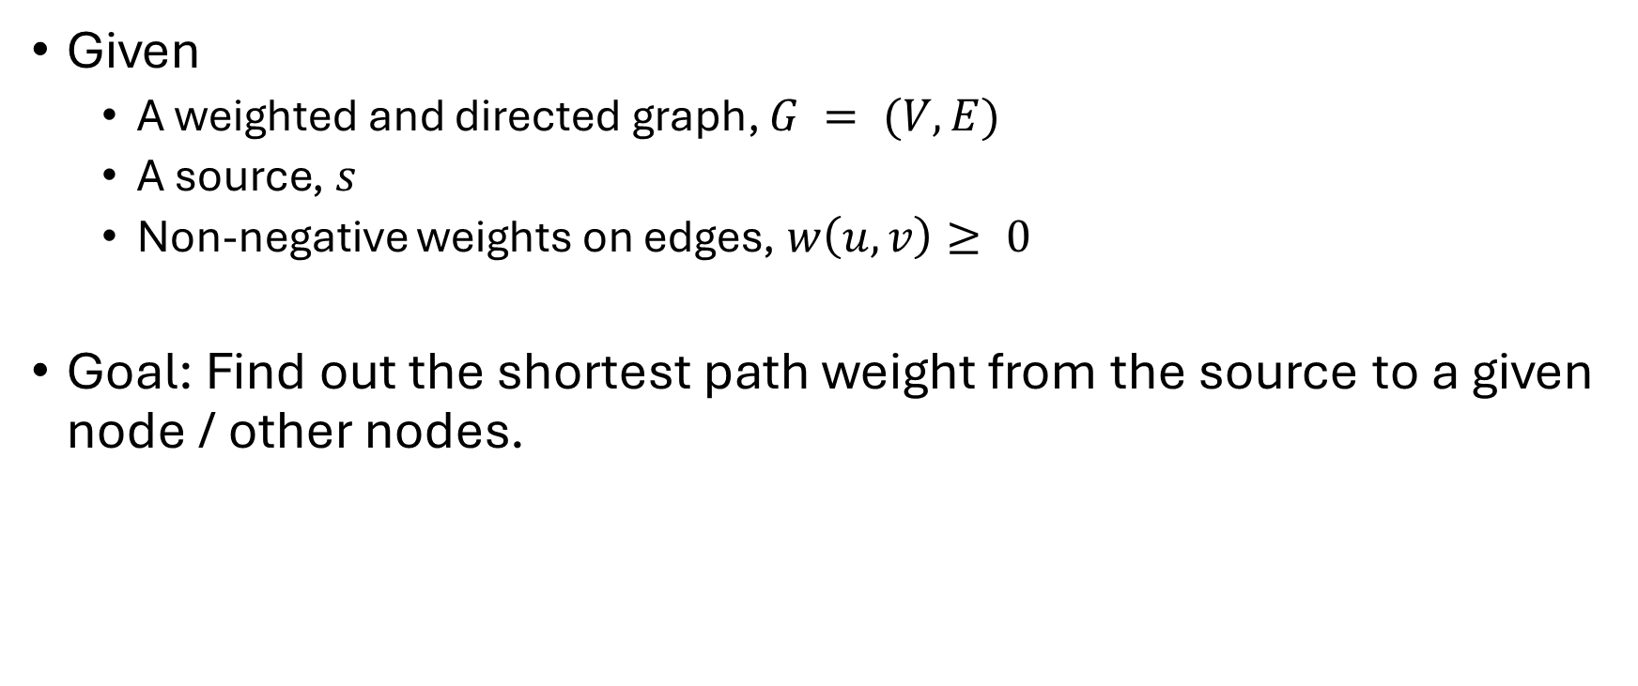
Dijkstra’s Algorithm
Given
A weighted and directed graph, $G = (V, E)$
A source, $s$
Non-negative weights on edges, $w\left(u, v\right)≥ 0$
Goal: Find out the shortest path weight from the source to a given node / other nodes.

Slide 28



Dijkstra’s Algorithm
A path weight of a, $p= <v_{1},v_{2}, …, v_{k}>$, is
Shortest path weight is defined as,

Slide 29
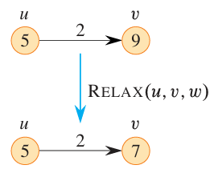
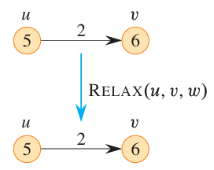

Dijkstra’s Algorithm
Relaxation
$x.d$ best known estimate of the shortest distance from s to x
$$\text{v}\text{.}\text{d}\text{ = }\text{min}\text{(}\text{v}\text{.}\text{d}\text{ , }\text{u}\text{.}\text{d}\text{ + }\text{w}\text{(}\text{u}\text{,}\text{v}\text{))}$$

Slide 30
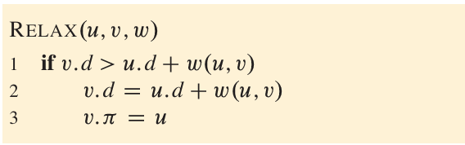
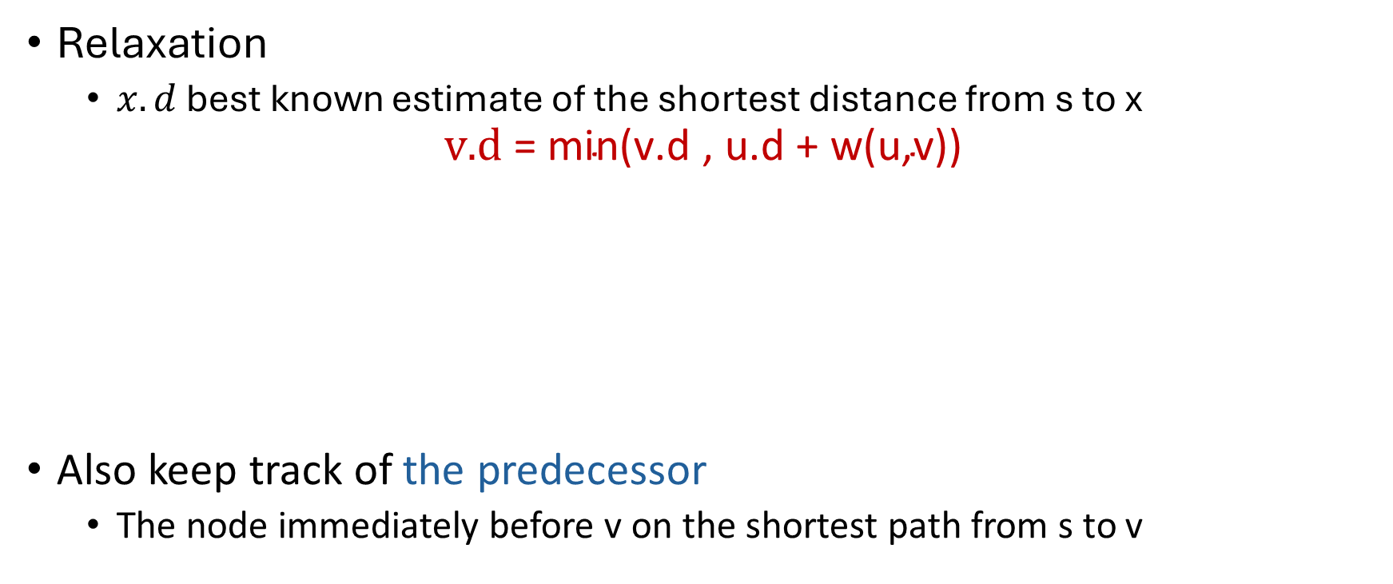
Dijkstra’s Algorithm
Relaxation
$x.d$ best known estimate of the shortest distance from s to x
$$\text{v}\text{.}\text{d}\text{ = }\text{min}\text{(}\text{v}\text{.}\text{d}\text{ , }\text{u}\text{.}\text{d}\text{ + }\text{w}\text{(}\text{u}\text{,}\text{v}\text{))}$$
Also keep track of the predecessor
The node immediately before v on the shortest path from s to v

Slide 31
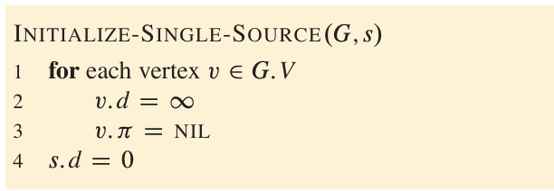
Dijkstra’s Algorithm
Initialization

Slide 32
Dijkstra’s Algorithm
Remember BFS?
At each step, pick the next node from discovered nodes in the queue
Dijkstra’s Algorithm
Similar to BFS
Except that at each step, pick the next node with the minimum estimated shortest-path weight
Replace the FIFO queue of BFS with a minimum priority-queue
The greedy choice!!!!

Slide 33
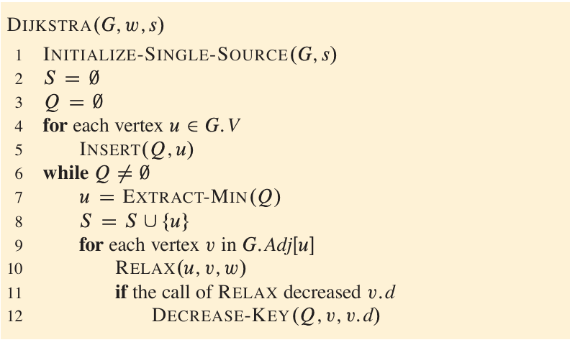
Dijkstra’s Algorithm

Slide 34
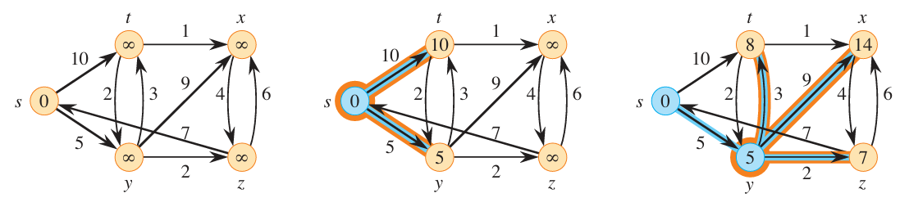
Dijkstra’s Algorithm

Slide 35
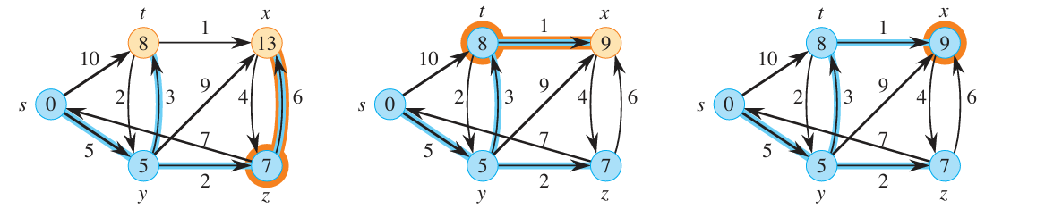
Dijkstra’s Algorithm

Slide 36
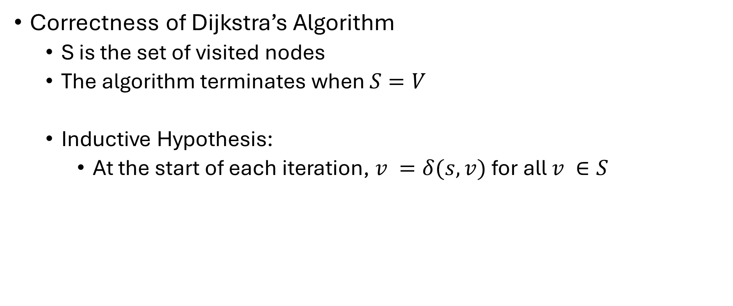
Dijkstra’s Algorithm
Correctness of Dijkstra’s Algorithm
S is the set of visited nodes
The algorithm terminates when $S=V$
Inductive Hypothesis:
At the start of each iteration, $v =δ(s, v)$for all $v ∈S$

Slide 37
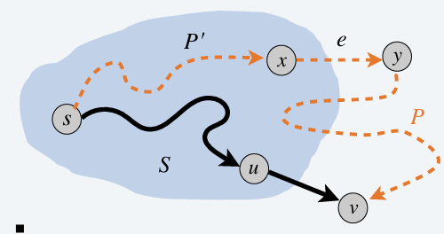
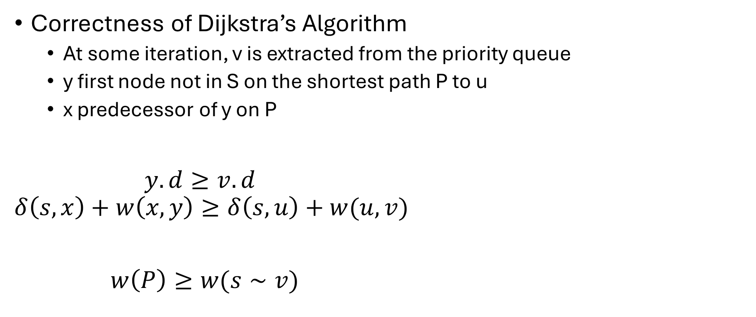
Dijkstra’s Algorithm
Correctness of Dijkstra’s Algorithm
At some iteration, v is extracted from the priority queue
y first node not in S on the shortest path P to u
x predecessor of y on P
$y.d≥v.d$
$$δ\left(s, x\right)+w\left(x, y\right)≥δ\left(s, u\right)+w(u, v)$$
$w\left(P\right)≥w(s∼v)$

Slide 38
Minimum Spanning Tree
A spanning tree is a tree that connects all of the vertices.
The cost of a spanning tree is the sum of the weights on the edges.
B
C
D
4
9
2
11
4
A
I
14
E
7
6
8
10
1
2
H
G
F

Slide 39
Minimum Spanning Tree
A spanning tree is a tree that connects all of the vertices.
The cost of a spanning tree is the sum of the weights on the edges.
8
7
B
C
D
It has cost 67
4
9
2
11
4
A
I
14
E
7
6
8
10
1
2
A tree is a connected graph with no cycles!
H
G
F

Slide 40
Minimum Spanning Tree
A minimum spanning tree is a tree with minimum cost that connects all of the vertices.
8
7
B
C
D
It has cost 37
4
9
2
11
4
A
I
14
E
7
6
8
10
1
2
H
G
F

Slide 41
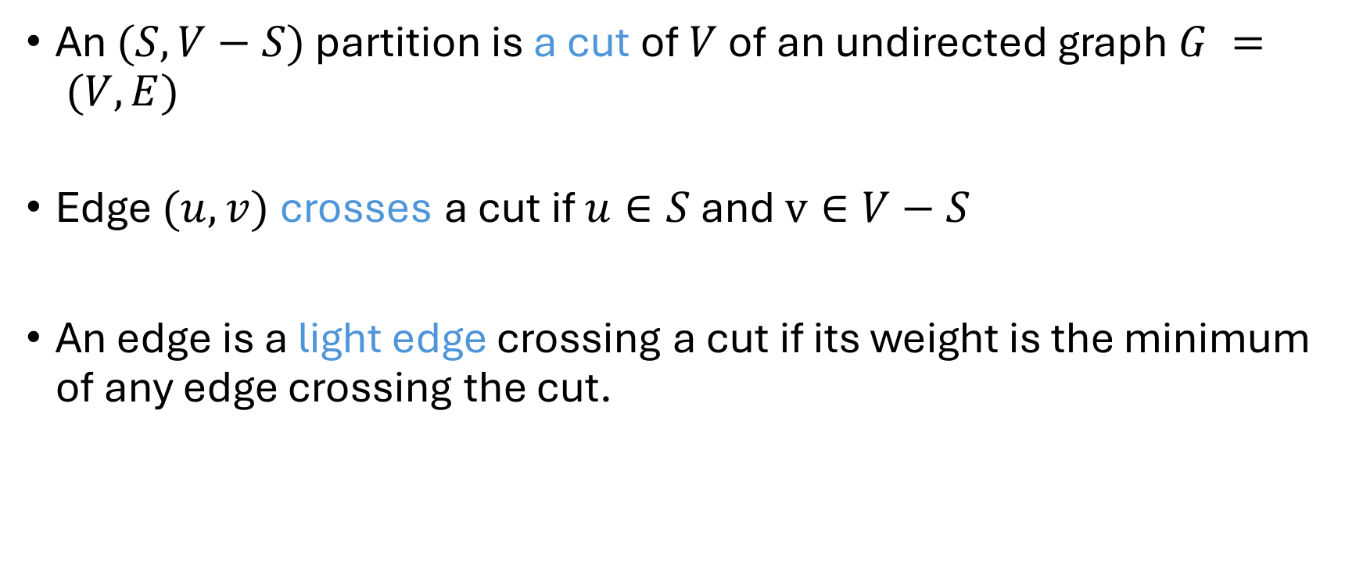
Some Definitions
An $(S, V−S)$ partition is a cut of $V$ of an undirected graph $G = (V, E)$
Edge $(u, v)$ crosses a cut if $u∈S$ and $v∈V−S$
An edge is a light edge crossing a cut if its weight is the minimum of any edge crossing the cut.

Slide 42
Minimum Spanning Tree
The strategy:
Make a series of greedy choices, adding edges to the tree.
Show that each edge we add is safe to add:
we do not rule out the possibility of success
Keep going until we have an MST.

Slide 43
Minimum Spanning Tree
Greedy strategy 1 (Prim’s Algorithm):
Start from an empty tree (a cut)
At each step, grow the tree (a cut) with a node that can be connected with minimum cost (i.e., grow the tree by adding the node on the other end of the light edge)
Terminate when all nodes are included in the tree

Slide 44
Prim’s Algorithm
8
7
Root Node
B
C
D
4
9
2
11
4
A
I
14
E
7
6
8
10
1
2
H
G
F

Slide 45
Prim’s Algorithm
8
7
B
C
D
4
9
2
11
4
A
I
14
E
7
6
8
10
1
2
H
G
F

Slide 46
Prim’s Algorithm
8
7
B
C
D
4
9
2
11
4
A
I
14
E
7
6
8
10
1
2
H
G
F

Slide 47
Prim’s Algorithm
8
7
B
C
D
4
9
2
11
4
A
I
14
E
7
6
8
10
1
2
H
G
F

Slide 48
Prim’s Algorithm
8
7
B
C
D
4
9
2
11
4
A
I
14
E
7
6
8
10
1
2
H
G
F

Slide 49
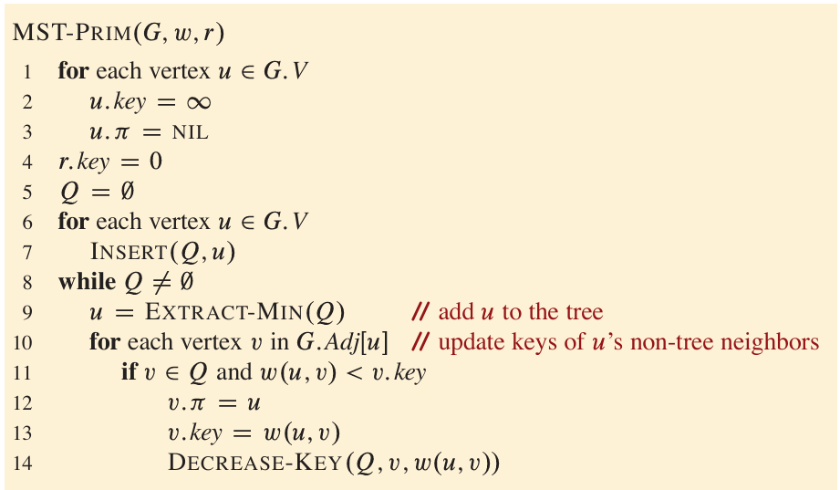
Prim’s Algorithm

Slide 50
Prim’s Algorithm
Proof of correctness?
Later

Slide 51
Minimum Spanning Tree
Greedy Strategy 2 (Kruskal’s Algorithm):
Start with each node as a separate tree
Consider the edges in ascending order of their weights
Include the minimum weight edge between two disjoint trees to connect them into a single tree
Discard the edge if it creates a cycle
Terminate when all the nodes are included

Slide 52
Kruskal’s Algorithm
8
7
B
C
D
4
9
2
11
4
A
I
14
E
7
6
8
10
1
2
H
G
F

Slide 53
Kruskal’s Algorithm
8
7
B
C
D
4
9
2
11
4
A
I
14
E
7
6
8
10
1
2
H
G
F

Slide 54
Kruskal’s Algorithm
8
7
B
C
D
4
9
2
11
4
A
I
14
E
7
6
8
10
1
2
H
G
F

Slide 55
Kruskal’s Algorithm
8
7
B
C
D
4
9
2
11
4
A
I
14
E
7
6
8
10
1
2
H
G
F

Slide 56
Kruskal’s Algorithm
8
7
B
C
D
4
9
2
11
4
A
I
14
E
7
6
8
10
1
2
H
G
F

Slide 57
Kruskal’s Algorithm
8
7
B
C
D
4
9
2
11
4
A
I
14
E
7
6
8
10
1
2
H
G
F

Slide 58
Kruskal’s Algorithm
Causing a cycle
8
7
B
C
D
4
9
2
11
4
A
I
14
E
!!!!!
7
6
8
10
1
2
H
G
F

Slide 59
Kruskal’s Algorithm
8
7
B
C
D
4
9
2
11
4
A
I
14
E
7
6
8
10
1
2
H
G
F

Slide 60
Kruskal’s Algorithm
8
7
B
C
D
4
9
2
11
4
A
I
14
E
7
6
8
10
1
2
H
G
F

Slide 61
Kruskal’s Algorithm
8
7
B
C
D
4
9
2
11
4
A
I
14
E
7
6
8
10
1
2
H
G
F

Slide 62
Kruskal’s Algorithm
8
7
B
C
D
4
9
2
11
4
A
I
14
E
7
6
8
10
1
2
H
G
F

Slide 63
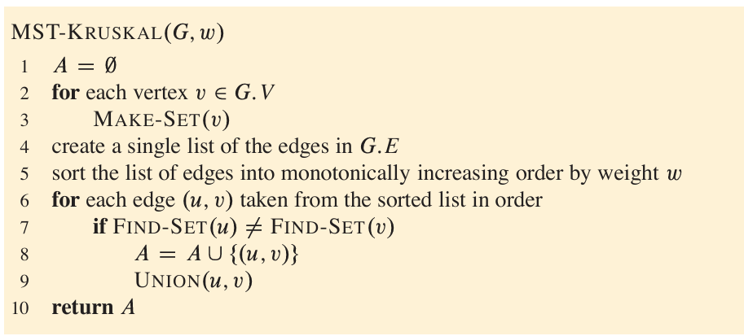
Kruskal’s Algorithm

Slide 64
Kruskal’s Algorithm
Proof of Correctness?
Later

Slide 65
Cut Property
Assume that all edge costs are distinct.
Let S be any subset of nodes that is neither empty nor equal to all of V, and let edge e =(v, w) be the minimum cost edge with one end in S and the other in V −S.
Then every minimum spanning tree contains the edge e

Slide 66
Correctness
Kruskal’s Algorithm
Apply cut property
Prim’s Algorithm
Apply cut property

Slide 67
Reference
Greedy Algorithms
CLRS 4th ed. Sections 15.1, 15.2
Dijkstra’s Algorithm
CLRS 4th ed. Sections 22 (intro), 22.3
Minimum Spanning Tree
CLRS 4th ed. Sections 21.1, 21.2
KT Section 4.5 (Correctness)

